Slide 1
First Hundred Days

Slide 2
The Challenge
Roosevelt must rally the people and instill faith in institutions
His first one hundred days in office produce a landslide of legislation and agencies
https://www.youtube.com/watch?v=XrWHVZPxceQ&t=66s

Slide 3
Situation
“Run on banks”
People continuing to pull all of their money out of banks, thousands collapsing
High unemployment
No jobs = no spending = economic standstill
Homes and farms being foreclosed
You have no money, no job, no home
No confidence in gov., banks, institutions, etc.

Slide 4
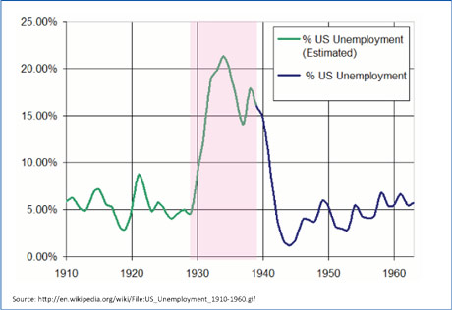

Slide 5
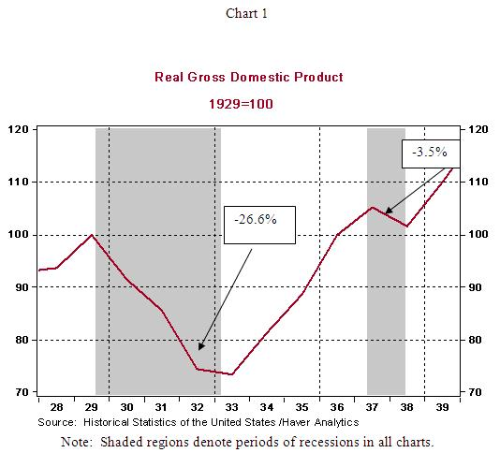
GDP is consumption, investment, exports, imports
Overall economic health

Slide 6
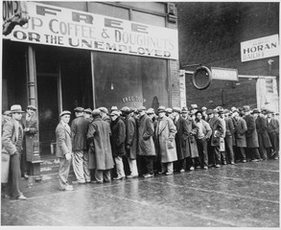

Slide 7
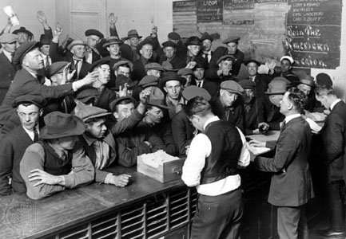

Slide 8
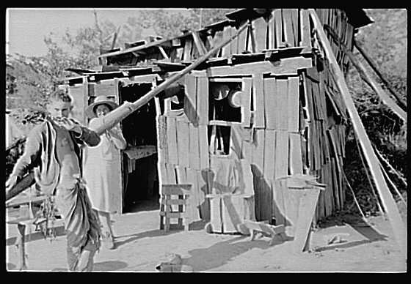

Slide 9
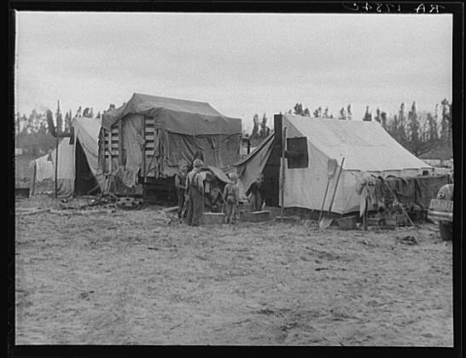

Slide 10
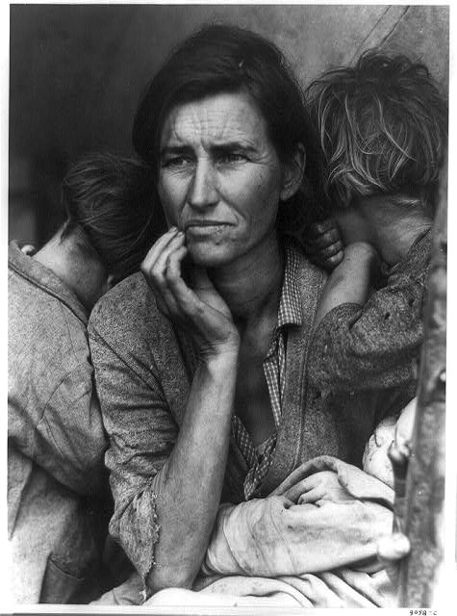

Slide 11
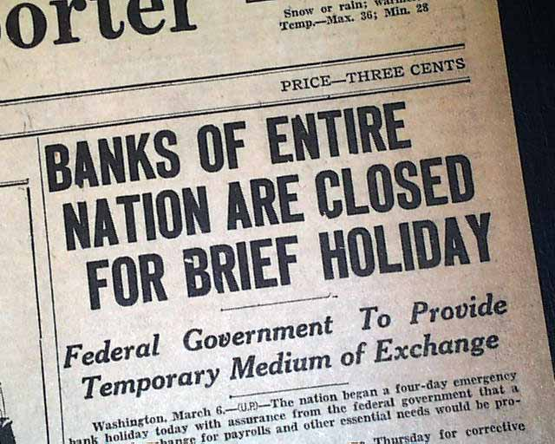
Response
Roosevelt institutes a bank holiday, closing the banks to stop the withdraw of money temporarily
Emergency Banking Relief Act
Federal Gov. would issue licenses to only those financially sound banks; help restore confidence

Slide 12
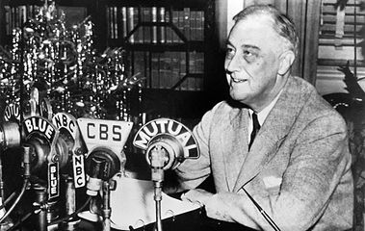
Fireside Chats
Roosevelt would come over the radio and millions would listen
Wanted to assure people their money was safe and their gov. could be trusted
When banks reopened many start depositing again
Restored the spirit of the people
https://www.youtube.com/watch?v=YOPm4H2k81s

Slide 13
The First New deal Poster Assignment
Landslide of legislation to help relieve the poor, recover the economy, and reform the system occurs
You and one partner will be assigned an agency, act, or term
Your job is to create a full sized colored propaganda poster advertising for your agency, act, or term
Your picture should cover the page, be colored, creative, and truly advertise/advocate for your agency, act, or term
On the back write an explanation of your poster and term
Presentations beginning of class Tuesday

