Slide 1
Read and annotate the article on President Warren Harding

Slide 2
Politics of the 1920’s

Slide 3
The Harding Administration
Secretary of Interior Albert Fall leased public land at Teapot Dome, WY to private companies
Took bribes for doing so; goes to prison
How does this affect the idea of an active government for progressive policies?
Leads to distrust in government whereas progressivism relied on honest and efficient government

Slide 4
Steamy
Warren Harding had many mistresses even going so far as to pay one of them off
Code Words
https://www.loc.gov/resource/mss48595.0102?sp=40&r=-0.159,-0.041,1.281,0.657,0
The letters
John Oliver Warren Harding

Slide 7
Silent Cal
Harding dies of a heart attack August 2, 1923
VP Calvin Coolidge takes over
Reporter once told him he had made a bet that he could get Cal to say more than two words. His response?
”You lose.”

Slide 8
Isolationism?
Americans tired of war overseas, wanted to stay out of world affairs
1920’s known as period of isolationism
Is it possible to be truly isolationist?

Slide 9
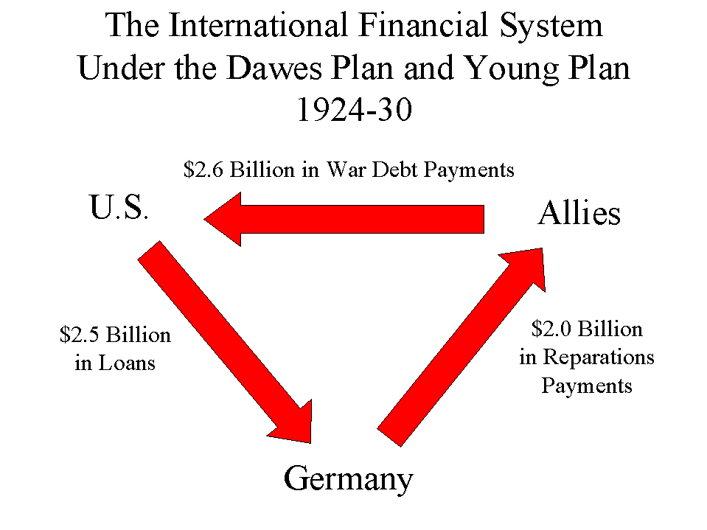
Isolationism?
Dawes Plan
Loaned money to Germany to pay Allies to pay US
Washington Conference
Attempt to quell aggressions and arms races
Kellogg-Briand Pact
Outlawed war

Slide 10
The Presidents Series: Harding and Coolidge
https://www.youtube.com/watch?v=7S_GvBM4-Dk
https://www.youtube.com/watch?v=IUkBE-OCHIU

