Slide 1
Imperialism

Slide 2
Letter To Mckinley
“I, Liliuokalani…do hereby solemnly protest against any and all acts done against myself and the constitutional government of the Hawaiian Kingdom…Now, to avoid any collision of armed forces and perhaps the loss of life, I do under this protest…yield my authority until such time as the Government of the United States shall,,,undo the action of its representatives and reinstate me in the authority which I claim as the constitutiutional sovereign of the Hawaiian Islands.”

Slide 3
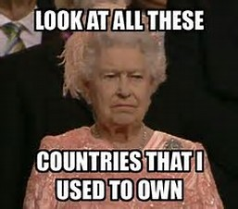
Imperialism
The policy in which stronger nations extend their economic, political, or military control over weaker territories
Why?
Global competition
Other countries already taking land (Africa, Asia)
Military strength
New markets
Producing more than enough for America
Cultural superiority
White supremacy
“Civilize” uncultured peoples

Slide 5
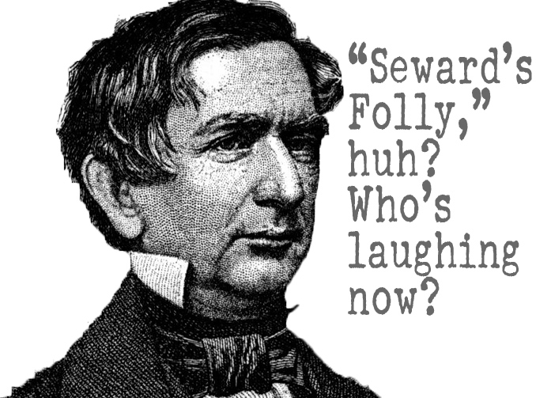
Alaska and Hawaii
Bought Alaska in 1867 (7 Mil)
“Seward’s Icebox/Folly” until they struck oil
Takes Samoa for ports (protectorate)
Large American sugar presence on Hawaii
Want annexation to avoid tariffs (foreign import)
Want naval base at Pearl Harbor
White plantation owners forced King Kalakaua to only give voting rights to wealthy landowners
Queen Liliuokalani takes over and wants reform
Overthrown by marines
Sanford Dole, wealthy sugar head, made head of government
Annexed as a territory in 1898

Slide 6
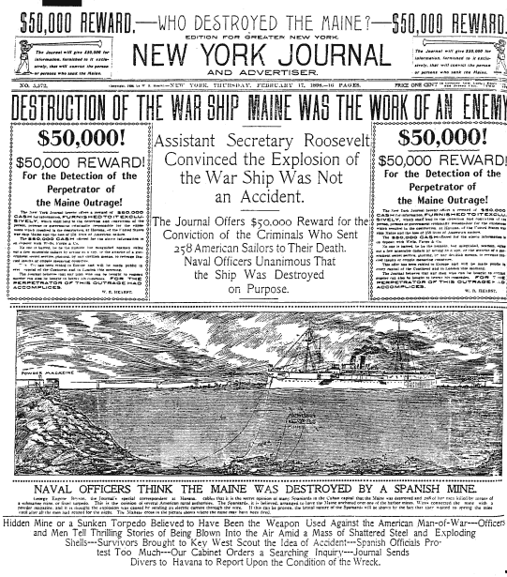
War With Spain
Yellow Journalism sways public sympathy towards the Cuban rebels trying to break from Spain
Sensationalized stories
McKinley, who becomes President in 1897, sends the battleship Maine to protect Americans in Havana, Cuba

