Slide 1
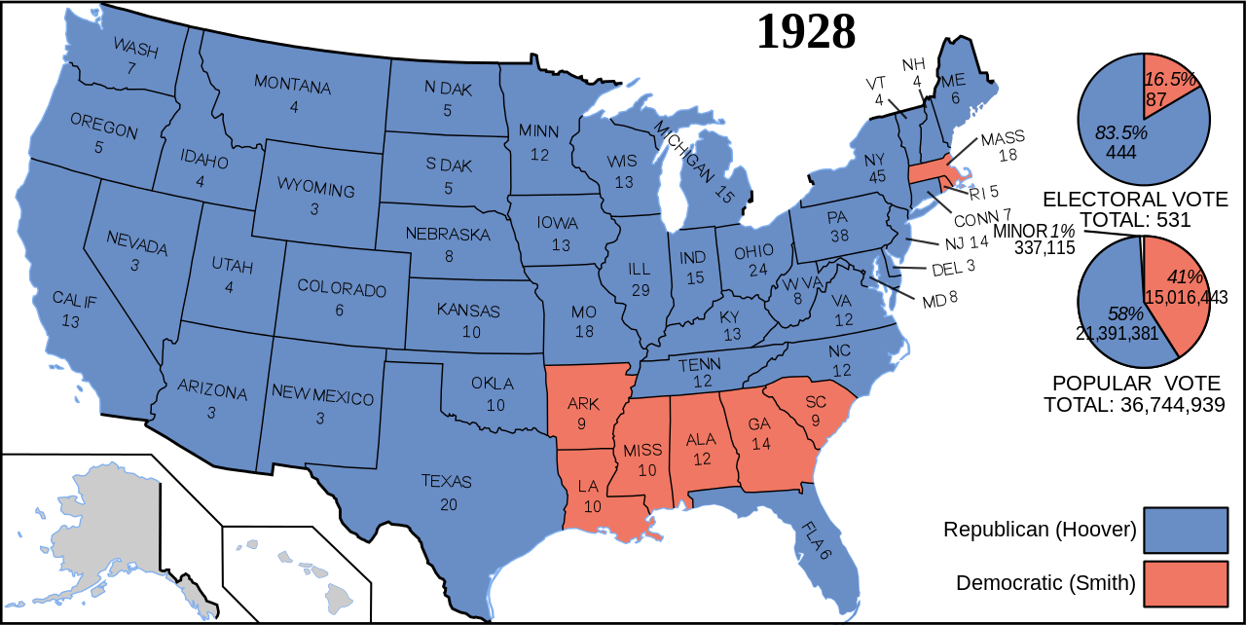

Slide 2
“We are nearer to the final triumph over poverty than ever before in the history of any land.”
-Herbert Hoover 1929

Slide 3
What was the Great Depression?
What makes it “great”?

Slide 4
Reviews: What Caused the Great Depression?
Overproduction
Low interest rates and efficient machines
Tariffs
Drive prices high
Unequal Income Distribution
Few can afford products; wages stagnant
Stock Market Crash
Buying stocks on margin and speculating
Extremely corrupt

Slide 5
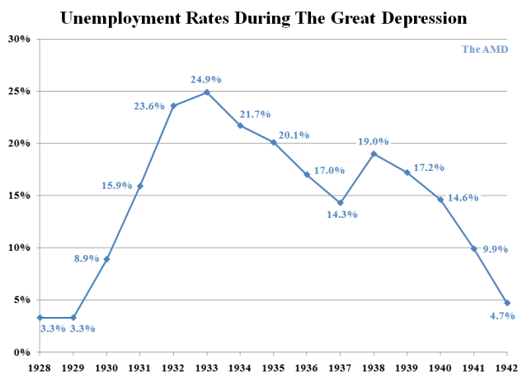
Machines, low interest rates, lead to efficiency/expansion, but prices high and so few have so much money (low wages)
Tariffs drive prices higher
Sales plummet, companies fire people
1929 Stock Market Crash wipes out savings and halt investment
No money, no jobs, no production
Top 5% held 30% of wealth

Slide 6
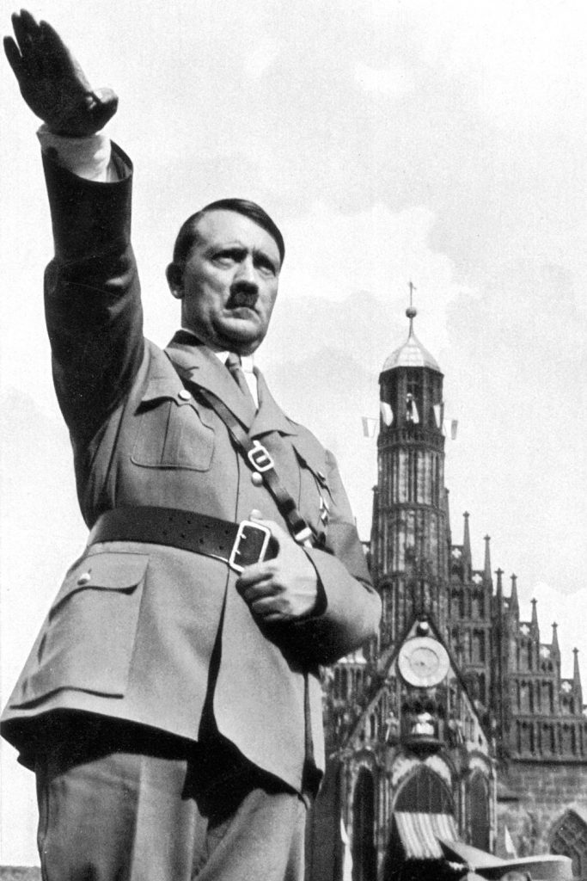
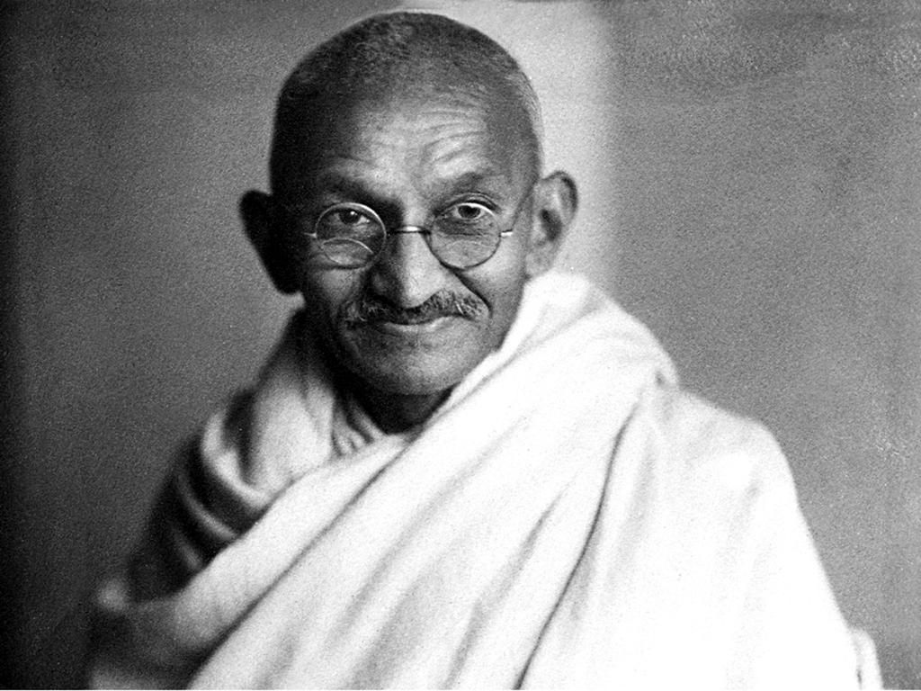
Consider This
What do people do when they are desperate?

Slide 7
GDP Activity

