Slide 1
JFK

Slide 2
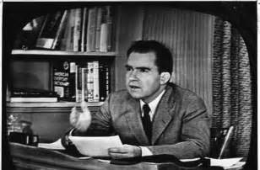
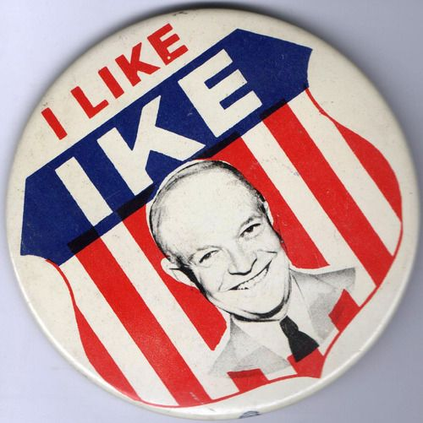
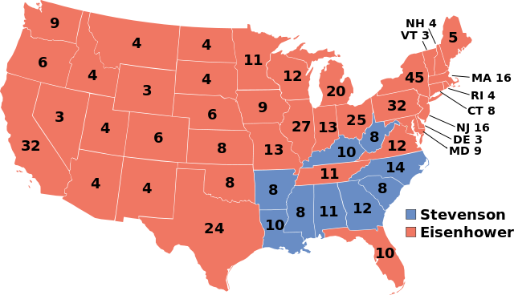
1952

Slide 3
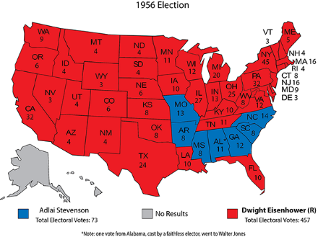
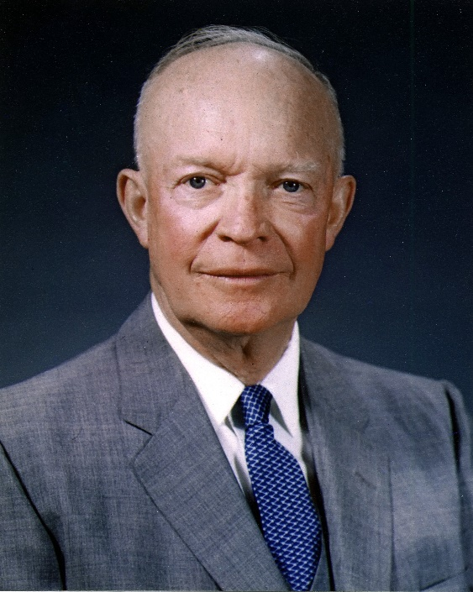

Slide 4
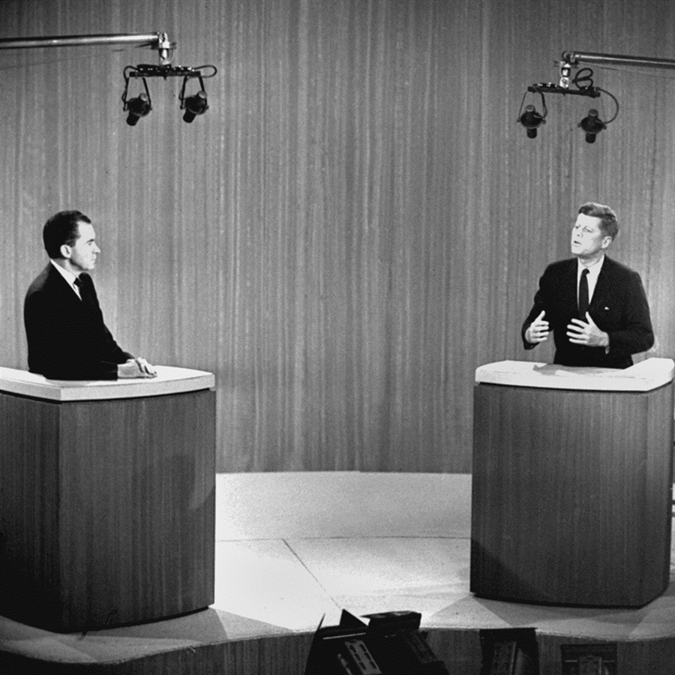
1960 Election
John F. Kennedy
Democratic Senator MA
Richard M. Nixon
Vice President
Televised Debates
First ever; how would this change campaigning?
Listeners thought Nixon won; Viewers thought Kennedy won
Kennedy-Nixon Debate
https://www.youtube.com/watch?v=4Y8SZDH3B_4

Slide 5
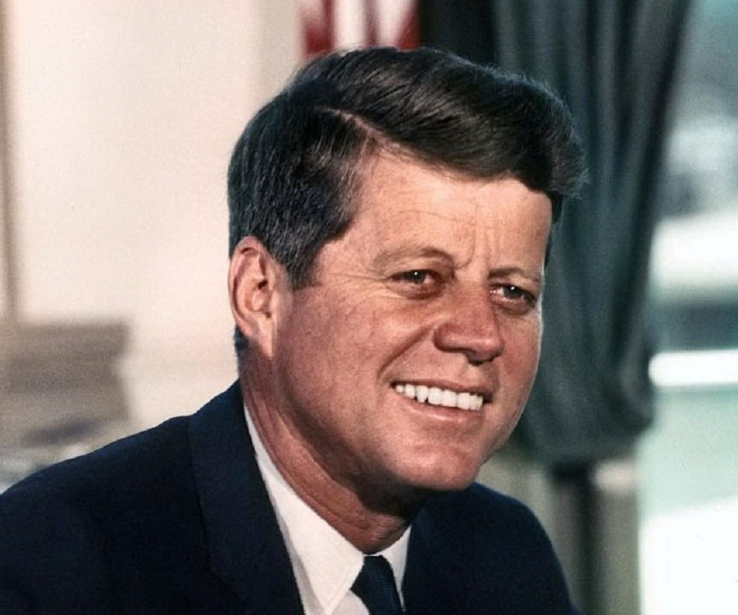
Issues
Americans had doubts about Kennedy
Inexperience
Roman Catholic
Had the image
Civil Rights
MLK arrested for sit-in
Eisenhower and Nixon were silent
JFK called his wife and RFK got him out of jail

Slide 6
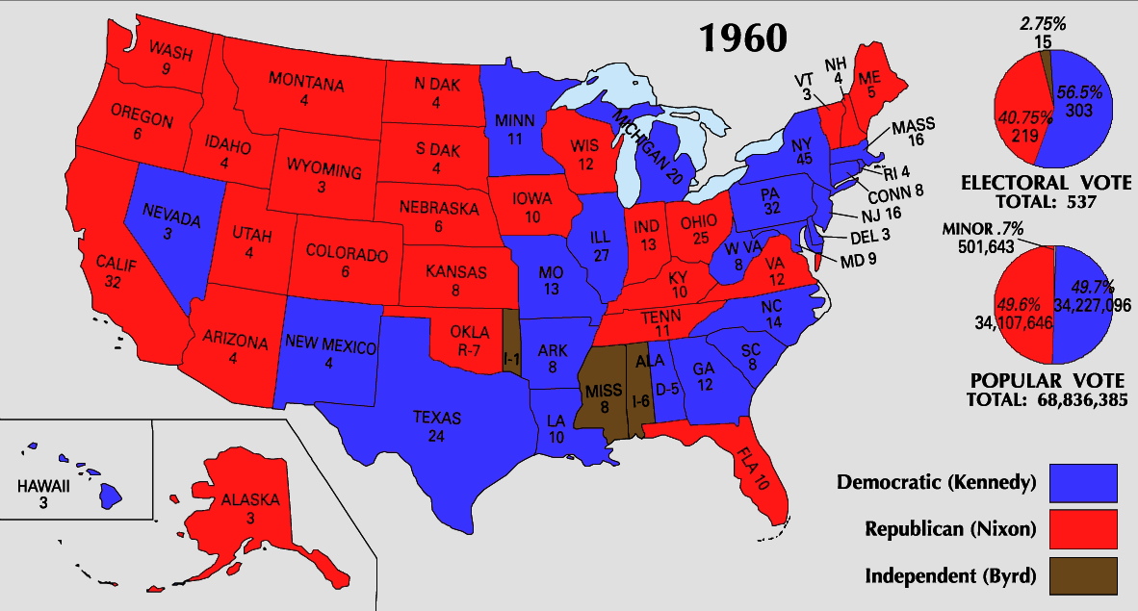

Slide 7
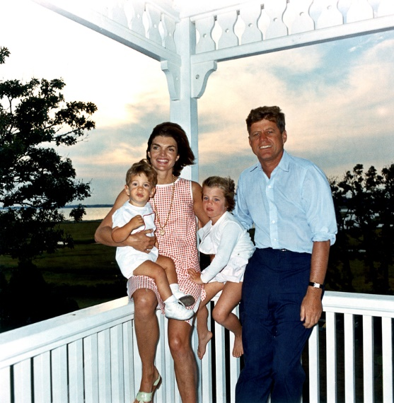
President Kennedy
Camelot
Camelot
Grace, elegance, wit
Contrast of what had come before (grandpa)
Inaugural Address
Gave his brother the job of Attorney General
Flexible Response
Broaden options beyond nuclear weapons
New Frontier (aiding the poor, education)

Slide 8
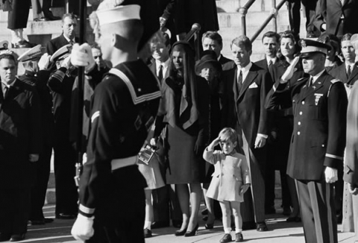
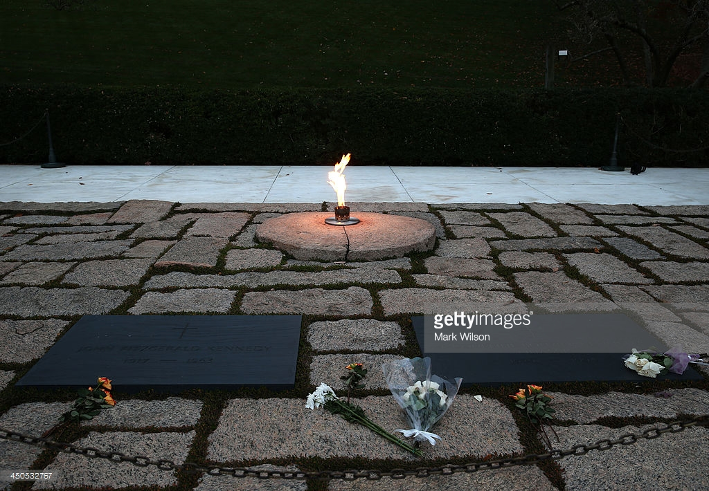
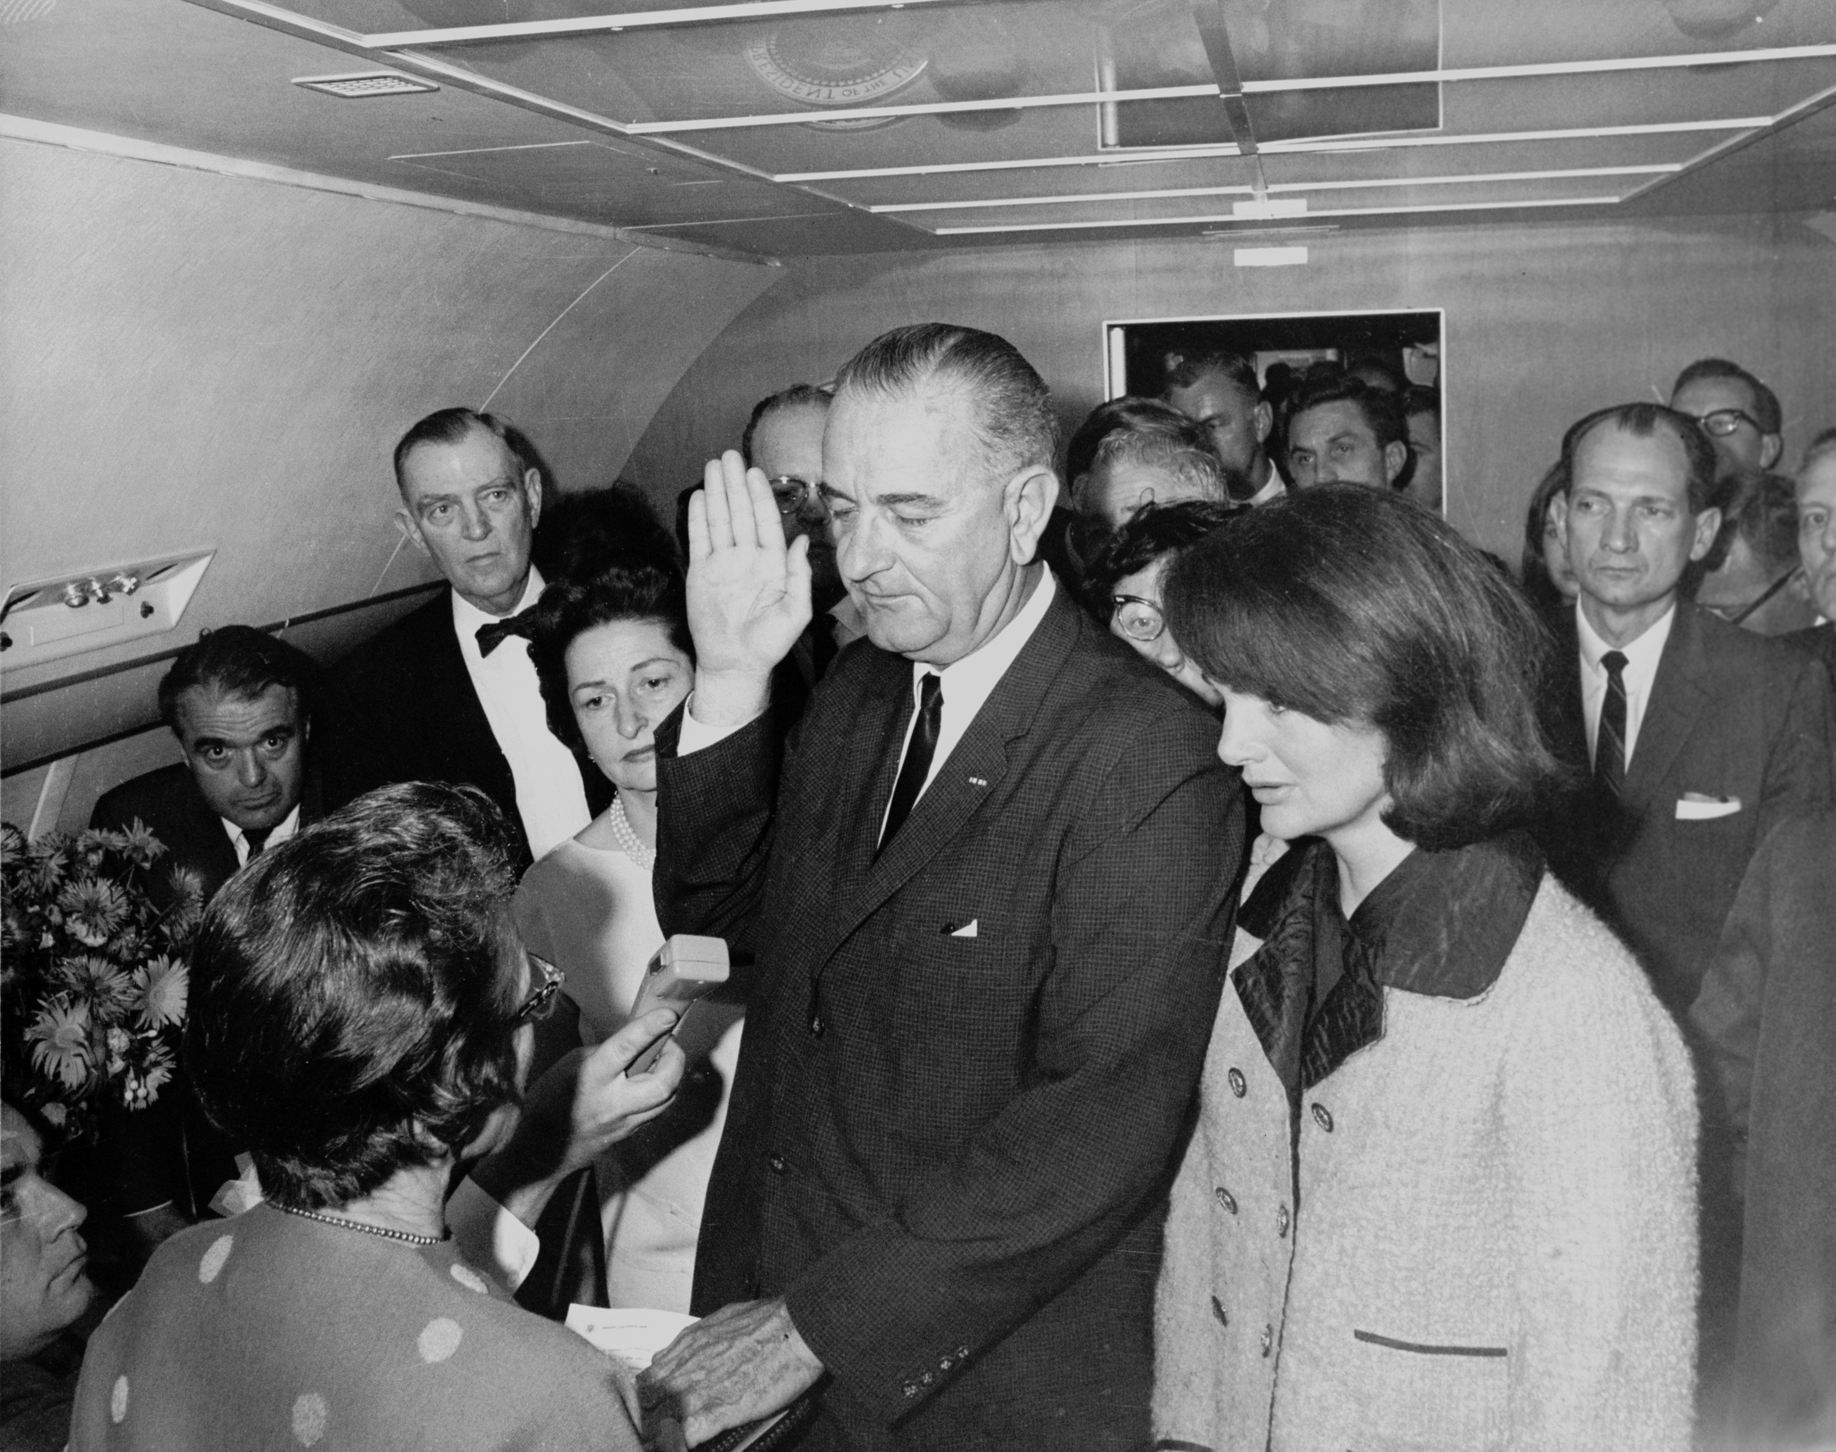
November 22, 1963
Zapruder Film
https://www.youtube.com/watch?v=6PXORQE5-CY
https://www.youtube.com/watch?v=j-KR9xwXqyk

Slide 9
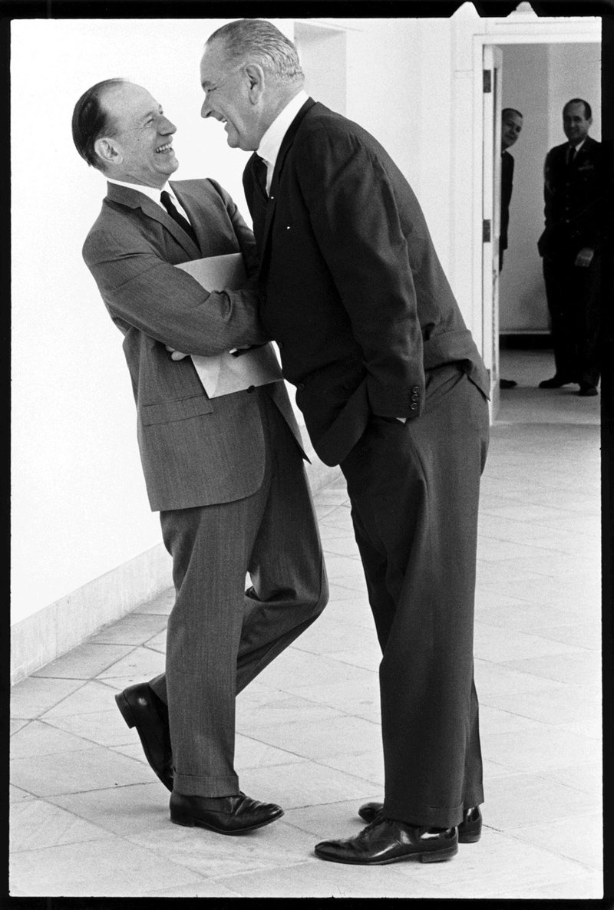
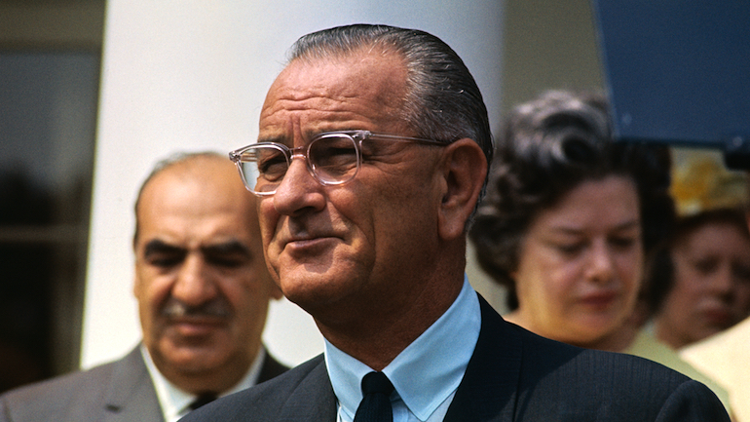
Lyndon Johnson
A larger than life figure
Wanted to create a “Great Society”
Eradicate poverty, racism,etc.

Slide 10
The Great Society Programs
In the graphic organizer copy the information from page 464 of your textbook
Homework: Chapter 15.2 powerpoint “JFK and the Cold War” is on my website. You are responsible for this information

