Slide 1
Korean War Timeline Answers

Slide 2
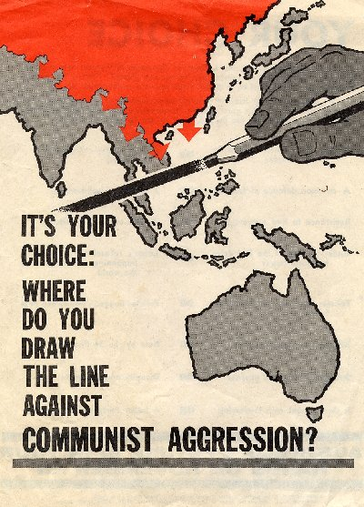
The Long Telegram/Containment

Slide 3
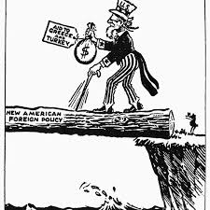
Truman Doctrine

Slide 4
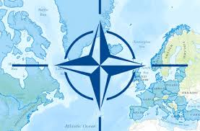
NATO

Slide 5
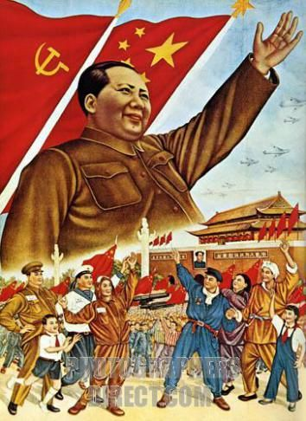
People’s Republic of China Established

Slide 6
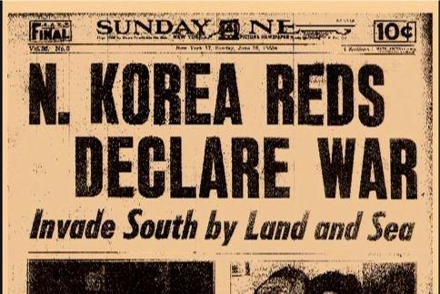
North Korea Invades South Korea

Slide 7
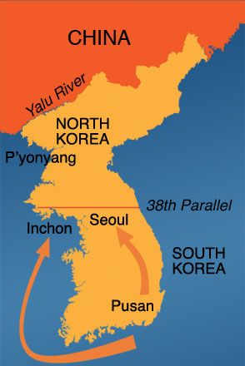
Macarthur invades inchon

Slide 8
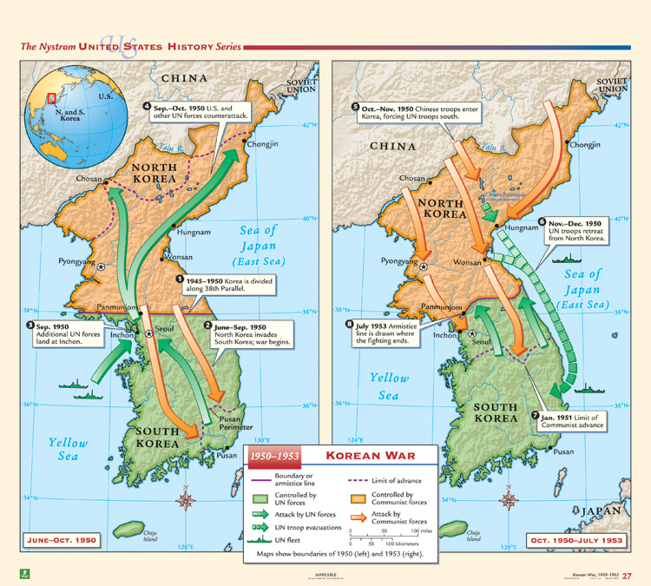
China Pushes Back

Slide 9
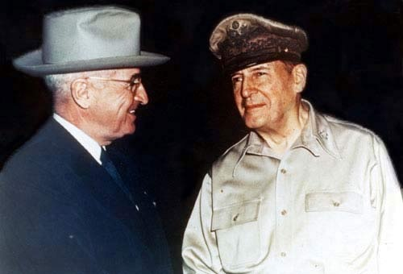
Truman Fires Macarthur

Slide 10
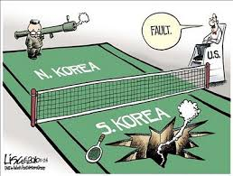
Armistice Signed

Slide 11
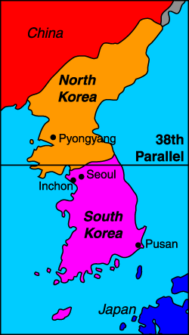
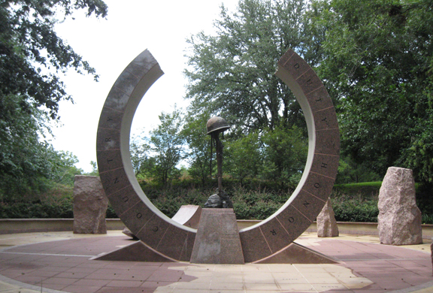

Slide 12
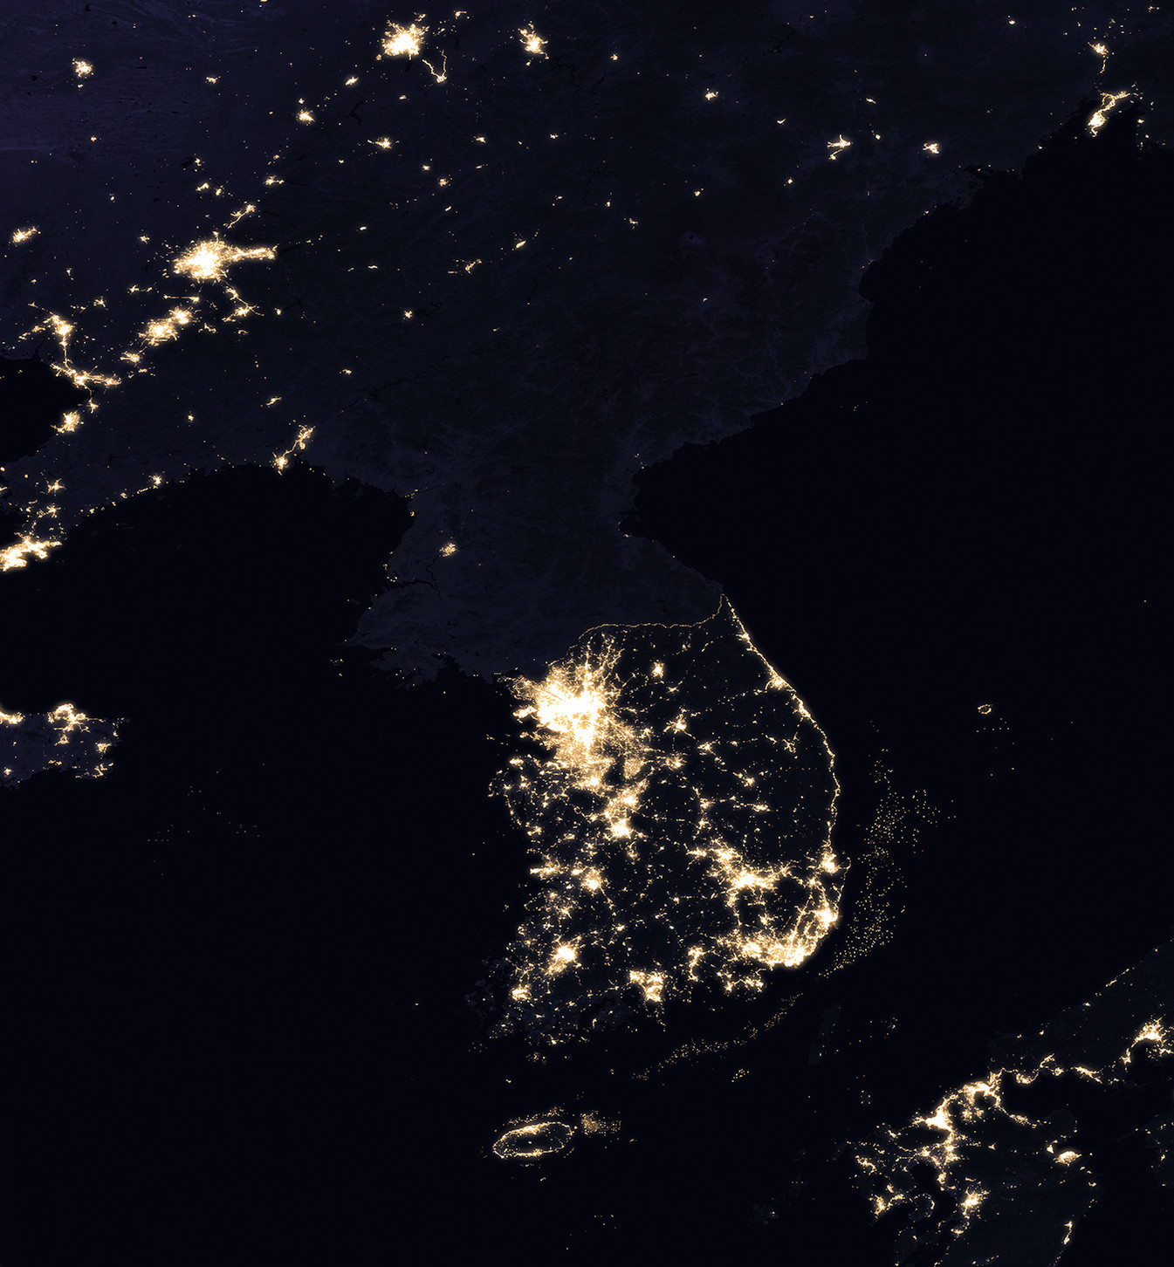
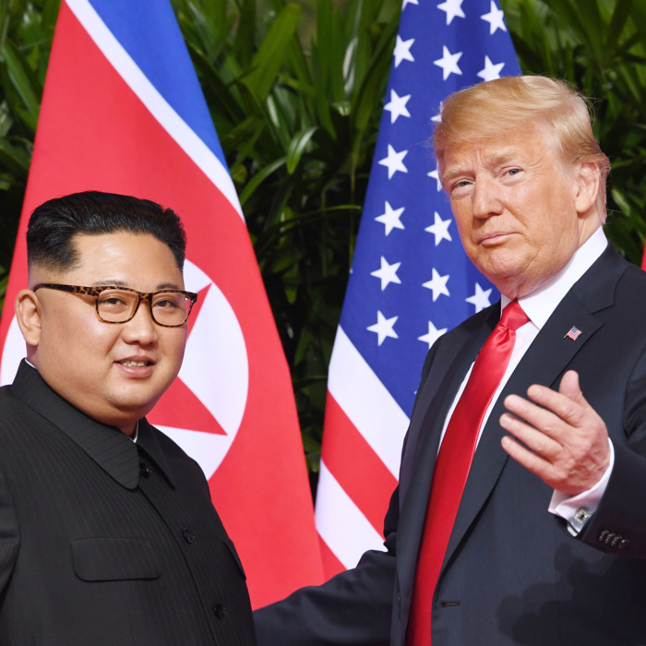
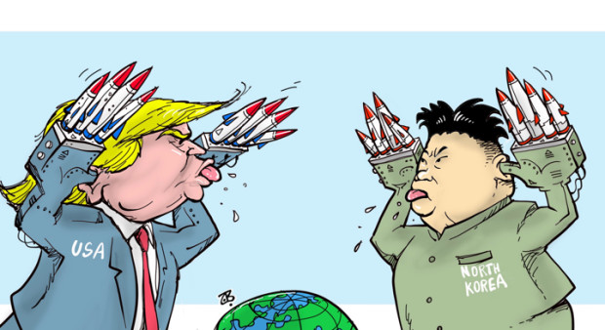
Pictures

Slide 13
McCarthyism Notes

Slide 14
School Oath
Amid the rise of radicalistic ideas Mr. Epting has requested that we have students sign the following half sheet
Choosing not to sign may result in investigation and probable expulsion

Slide 15
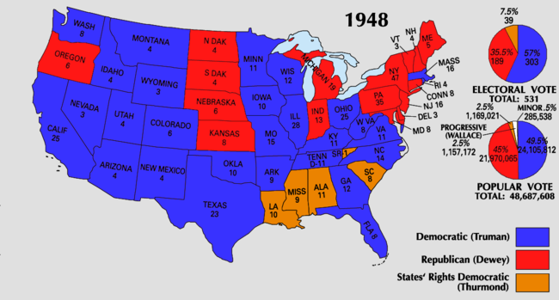
“DO Nothing congress” and the Fair Deal

Slide 16
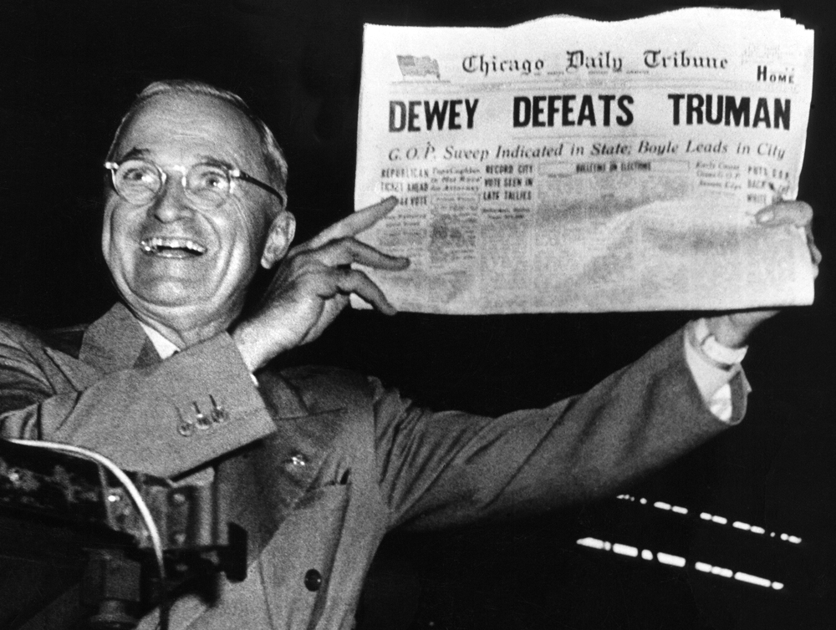

Slide 17
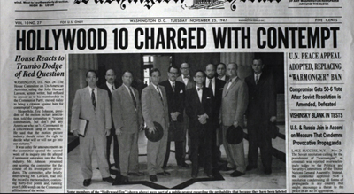
Suspicion
1950’s was prosperous and paranoid
Loyalty review program to screen federal employees for communist activity
How do you determine comm. activity?
HUAC (House Un-American Activities Committee)
Film industry questioned
“Hollywood Ten” refuse to testify
Blacklists created
Alger Hiss, a U.S. diplomat at Yalta, found to be a spy
“Pumpkin papers”
Julius and Ethel Rosenberg executed for espionage. Supposedly passed atomic secrets.

Slide 18
Joseph McCarthy’s Wheeling Speech
“While I cannot take the time to name all the men in the State Department who have been named as members of the communist Party and the members of a spy ring, I have here in my hand a list of 205 that were known…as being member of the Communist Party and who nevertheless are still working and shaping the policy of the State Department.”

Slide 19
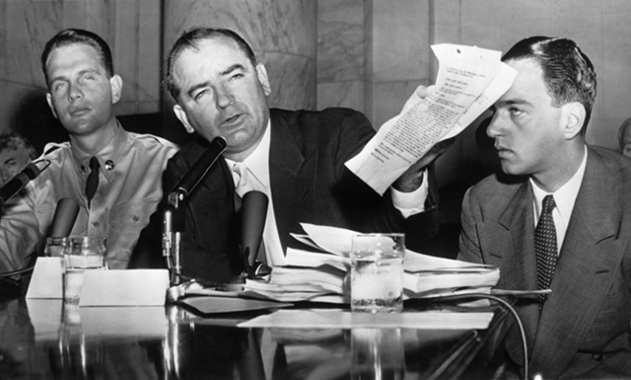
Mccarthyism
Accused SoS Acheson and George Marshall of disloyalty
McCarran Act (Internal Security Act)
All Communist organizations must register with gov.; could be arrested for national security purposes
No passports, and records must be published
Held hearings with vague, unfounded charges
Went for the army…Not a good idea!
https://www.youtube.com/watch?v=8llS0ZkLVGA

Slide 20
Paranoia: The Communist Activity
You will receive a slip of paper
An eagle means you are not a Communist
A hammer and sickle means you are a Communist
You are not allowed to reveal your paper to anyone
Your task is to form a group without any Communists
The largest group with no communists formed wins extra credit
If a communist is found to be in your group you lose
Communists: your task is to successfully infiltrate. If not a single fully non-Communist group is formed, then you win!
Remember you can only ask questions…you will be disqualified if you show anyone your slip of paper

