Slide 1
New Deal Coalition

Slide 2
The Coalition
Democrats had a unifying message of helping all working class people
Problem today?
Eleanor Roosevelt brought in African Americans (Rep.) and women
Solid South, farmers, African Americans, workers, immigrants, progressives, etc.
Wins Re-election despite GD still happening

Slide 4
The Court

Slide 5
Shechter Poultry Corporation v. U.S. (1935)
Why is this important?

Slide 6
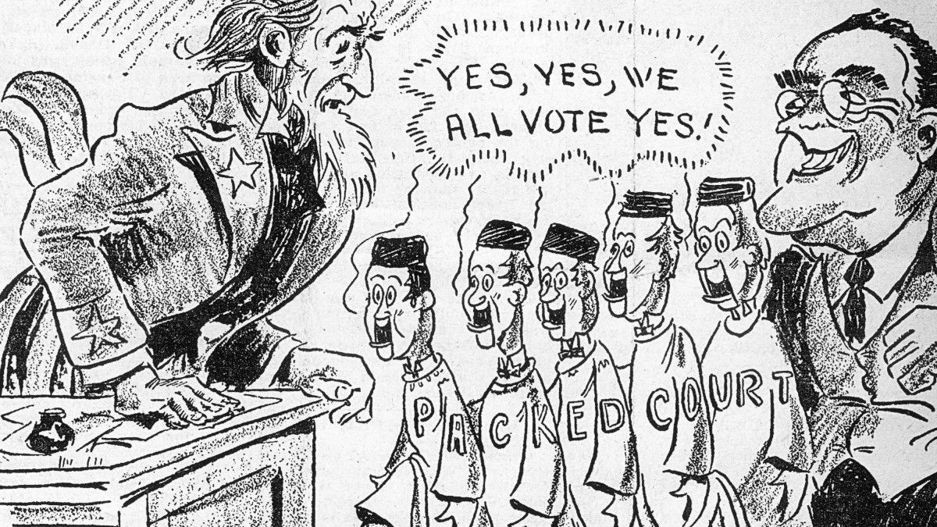
Court Packing Plan
The Supreme Court begins to strike down parts of Roosevelt’s New Deal
Roosevelt devises a plan
Increase the number of justices
Allow the President to appoint another new justice for every current justice over 70
Would allow Roosevelt to appoint up to six new justices
Seen as executive overreach and violating separation of powers
Backs off; Switch In Time That Saved The Nine

Slide 7
Role of Gov.

Slide 8
Brainstorm
What should the role of government be?
Consider the things you believe the federal government should be responsible for
What should the role of government not be?
What things do you believe the federal government should not be involved in/have control over?

Slide 9
New Roles For Gov.
Broker State
Government works out conflict among different interests
Welfare State
Safety net protecting Americans from economic disaster
Some see as handouts

Slide 10
New Deal Critics
Huey Long
Wanted more intervention from gov. and income redistribution
Many believed the gov. was going too far
Deficit Spending
Spending more than you collect in revenue
Debt is the accumulation of deficits
Debt Clock
https://www.youtube.com/watch?v=So2OQW6gR6I

Slide 11
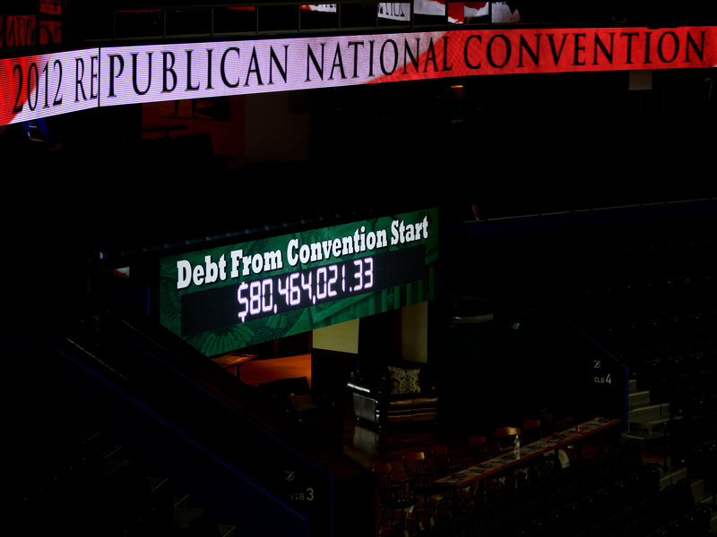
Republicans and Democrats both talk big about the debt and spending when out of power, but when in power it benefits them politically to enact programs and spend more
https://www.nytimes.com/interactive/2018/02/08/us/politics/budget-deficits-debt-bipartisan-spending-bill.html
Example: Republican Debt Clock at convention vs. Republican Congress and President voting to increase spending

Slide 12
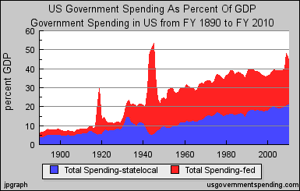

Slide 14
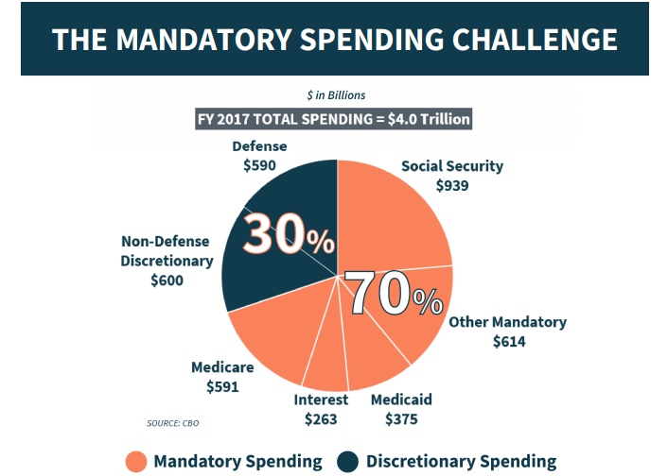
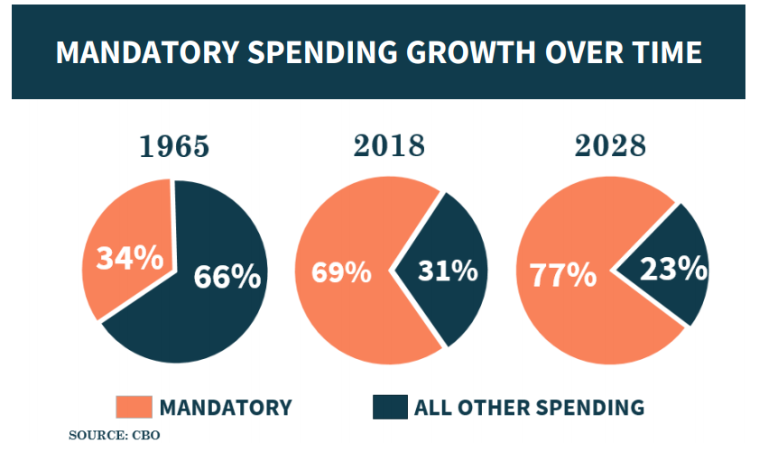

Slide 15
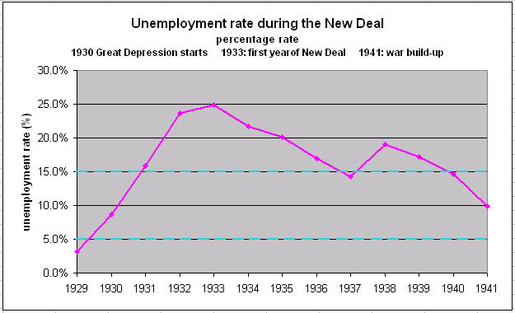
New Deal Legacy
Increased power of the federal government to support the needy and intervene in the economy
Did it work?

