Slide 1
Using Chapter 16 of your textbook fill out the Civil Rights Groups Graphic Organizer

Slide 2
“I guess it is easy for those who have never felt the stinging darts of segregation to say “wait.”But when you have seen vicious mobs lynch your mothers and fathers at will and drown your sisters and brothers at whim; when you have seen hate-filled policemen curse, kick, brutalize and even kill your black brothers and sisters; when you see the vast majority of your twenty million Negro brothers smothering in the air-tight cage of poverty; when you have to concoct an answer for a five year old son asking, ‘Daddy, why do white people treat colored people so mean?’ Then you will understand why we find it difficult to wait.”

Slide 3
Protest

Slide 4
Protest
Why do people protest?
Variety of issues spark protests
Examples?
To gain publicity, disrupt everyday life
Physical manifestation of ideals, emotions, etc.
What makes a successful protest?
1. Define the change you wish to see
2. Garner public support, don’t turn off potential allies with overly adversarial tactics. Must be positive.
3. Identify pillars of power in charge of change. Decide how to influence that change. Think: Why should they listen at all?
4. Survive the victory.

Slide 5
Non-Violent Protest
What is it?
Non-retaliation; passive resistance
Why choose it?
Violence distracts from political goals
How?
Intense training
Attitude, singing for focus and unity, planning
What if you are attacked?
Dropping to ground and protecting head/neck
Police often on the side of attackers or one of them

Slide 6
Read and annotate the excerpts of Martin Luther King’s “Letters From A Birmingham Jail”
Answer the questions that follow in complete sentences on your own sheet of paper
Due Tomorrow at the beginning of class

Slide 7
3/29
Turn in annotated reading with questions and answers
Review Answers

Slide 8
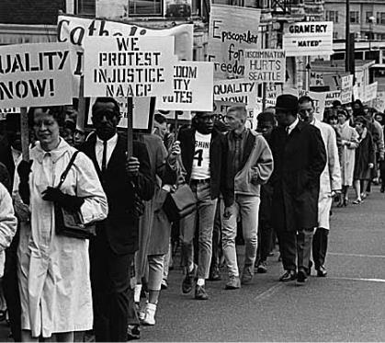
Boycott
In the wake of Rosa Parks the Montgomery Improvement Association elects Martin Luther King, a 26 year old pastor, to lead their boycott
Why boycott the buses?
Supreme Court ruled to integrate buses

Slide 9
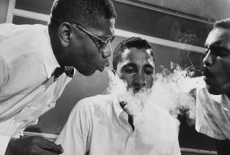
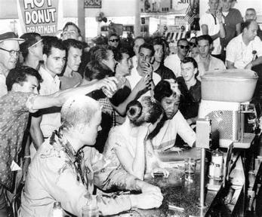
Sit Ins
Simulation
Volunteers went through intense training
February 1st, 1960 Woolworth Diner in NC
Movement spreads quickly
John Lewis
The Butler Sit In Scene

Slide 10
Freedom Riders
Rode buses into the deep South to integrate bus terminals
Often met with violence by KKK supported by law enforcement officials and ignored by government
https://www.youtube.com/watch?v=J8WnT6v_W3o
Mississippi Burning
Ronald Reagan
https://www.youtube.com/watch?v=nyeN2w-KKzk

Slide 11
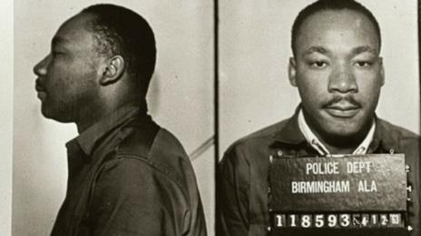
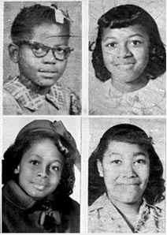
Protest
Birmingham
https://www.youtube.com/watch?v=q-MuWDsv5pg
Children’s March
https://www.youtube.com/watch?v=ggUt0gJh9U8
Letters From A Birmingham Jail

Slide 12
March On Washington
250,000 gather on the National Mall (I Have A Dream)
Leads to Civil Rights Act 1964
Bans discrimination on the basis of race in public places and employment
How can the government tell people who they can serve? Don’t you have a right to association?
Stalled in the Senate for weeks due to filibusters
Led by Southern Democrats with a few Republicans
Begins shift of the South towards Republicans; still happening today

Slide 14
“There goes the South for a generation”

Slide 15
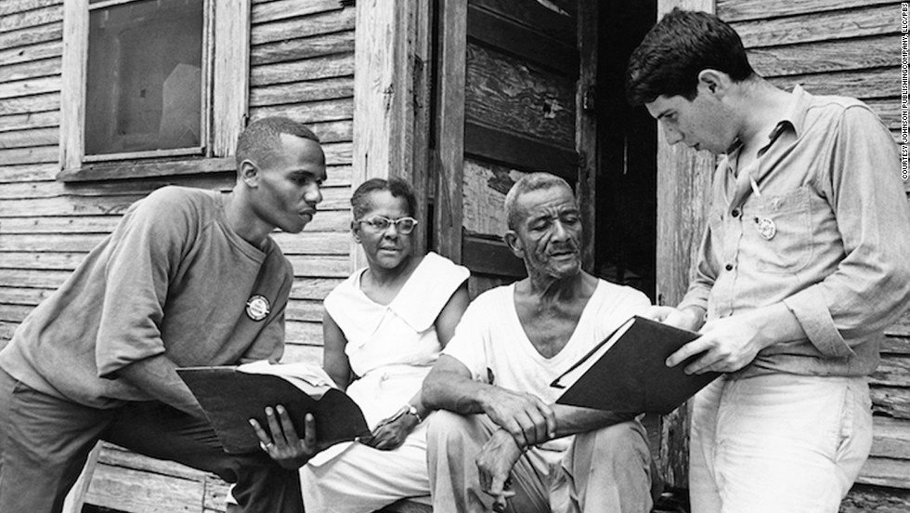
Freedom Summer
Movement to register African Americans to vote
Trained student volunteers in non-violent resistance
https://www.youtube.com/watch?v=T0_CJkkuNhs

Slide 16
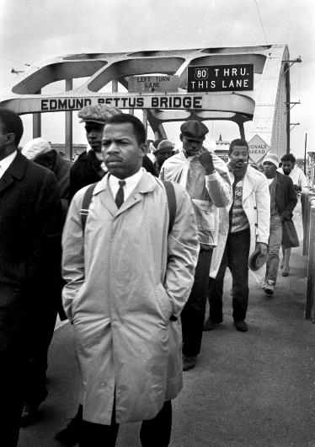
Selma
Planned to march from Selma to Montgomery March 7, 1965
Cross the Edmund Pettis Bridge to violence
“Bloody Sunday”
https://www.youtube.com/watch?v=tVymzWrBTww
Footage shocks the nation
Peaceful Protest

Slide 17
Voting Rights Act 1965
https://www.youtube.com/watch?v=MxEauRq1WxQ
Allowed federal examiners to oversee voter registration
Eliminated literacy tests
Dramatic rise in African American voters, elected officials
Could you pass a literacy test? In partners, answer the questions. The group with the most right at the end of the period will earn extra credit.

