Slide 1
Reconstruction

Slide 2
Lincoln
Amnesty to most southerners
10% Oath of loyalty
Johnson
Similar to Lincoln’s
Amnesty to all except general’s and wealthy planters
Radical Republicans
Resisted both plans
Wanted to prevent old Confederate leaders from returning to power; protections for African Americans
Military Reconstruction Act
South divided into 5 military districts
Accept 13-15th Amendments
Nothing about rights for former slaves
Must ratify 14th and 15th amendments to be readmitted
Supported by Radical Republicans

Slide 3
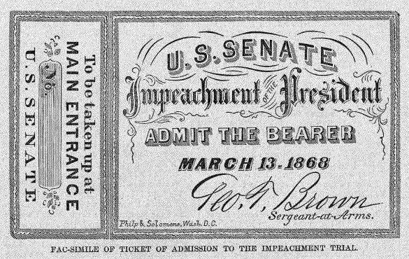
Impeachment
Andrew Johnson impeached for violating the “Tenure of Office Act
Fired Edwin Stanton
Impeached in the House, acquitted in the Senate

Slide 4
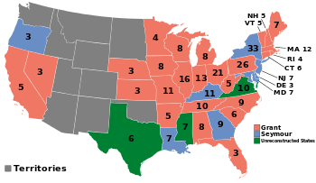

Slide 5
Life after war
African Americans and Republicans take over southern government
Carpetbaggers and Scalawags
Freedmen’s Bureau- help newly freed slaves
Short lived as Democrats regained control
KKK-undermined AA
Black Codes- restrict civil rights of AA
Indebted sharecroppers

Slide 6
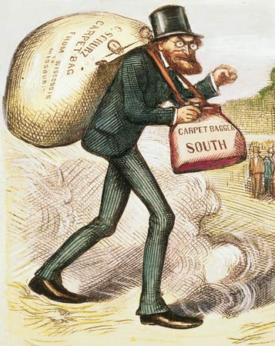

Slide 7
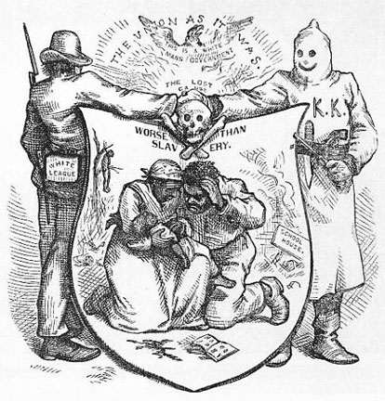

Slide 8
Compromise of 1877
Election day comes and 19 electoral votes from the South are disputed
The Deal: Democrats in the South will give those electoral votes and the presidency to the Republican (Hayes) in exchange for the removal of federal troops
Reconstruction ends

Slide 9
